Slide 1
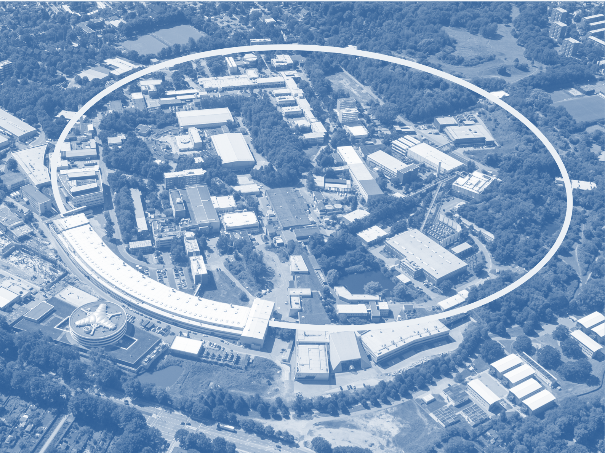
Perfomance issues in Serial and Mesh&Collect-type of experiments
Gleb Bourenkov, EMBL Hamburg
ISPyB – MXCuBE meeting
Diamond Light Source, 01/02/2018
Notes:
<number>

Slide 2
Outline
Serializing the scans
Scan parameter validation
On-the-fly processing with DOZOR
An alternative to diffraction-based sample location

Slide 3
Large content removed

Slide 4
Controls overhead in helical scan serialization
Year | Implementation | Overhead time per line
2013 | Control system level detector re-harnessed on each line | 10 sec
2014 | Diffractometer devices server Single acq. sequence at detector Alexander Gobo, EMBL-Gr | 1 sec aka “Fast Mesh”
2017 | Motion controller level Jeremy Sinoir, EMBL-GR | 0.1 sec

Slide 5
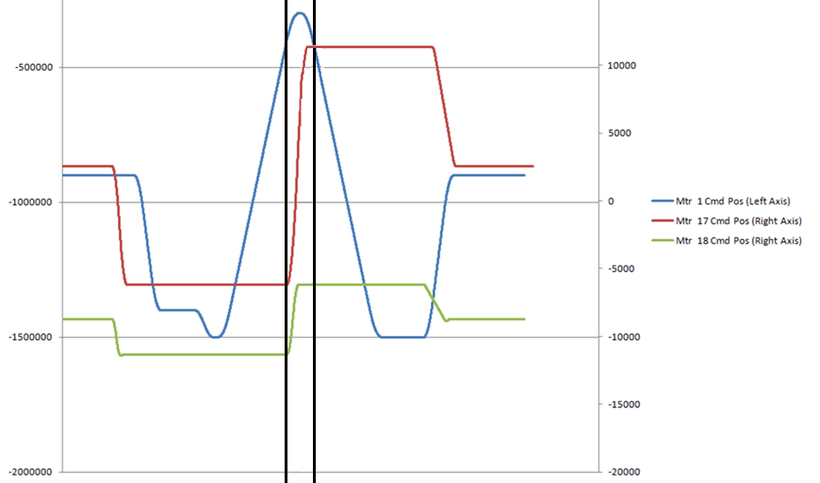
Sample displacement fits within the spindle acceleration time
Jeremy Sinoir
7th generation motion
controller
MD3up, ESRF ID23-1
Mon Feb 5 on MD3, P14

Slide 6
Scan parameter validation, Serial Helical Scan
Enter/validate while user is typing
exposure time
rotation per frame
Given a mesh, i.e.
Y Translation range
Number of frames
And constraints, i.e. hw MAX values:
Detector frame rate
Y Translation speed
Rotation speed
Rotation range

Slide 7
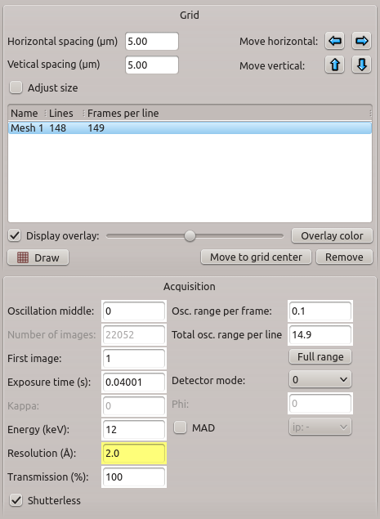
Solution: now in MXCuBE MinDiff HO
solving exact kinematic equations used in motor
controller for trajectory calulations

Slide 8
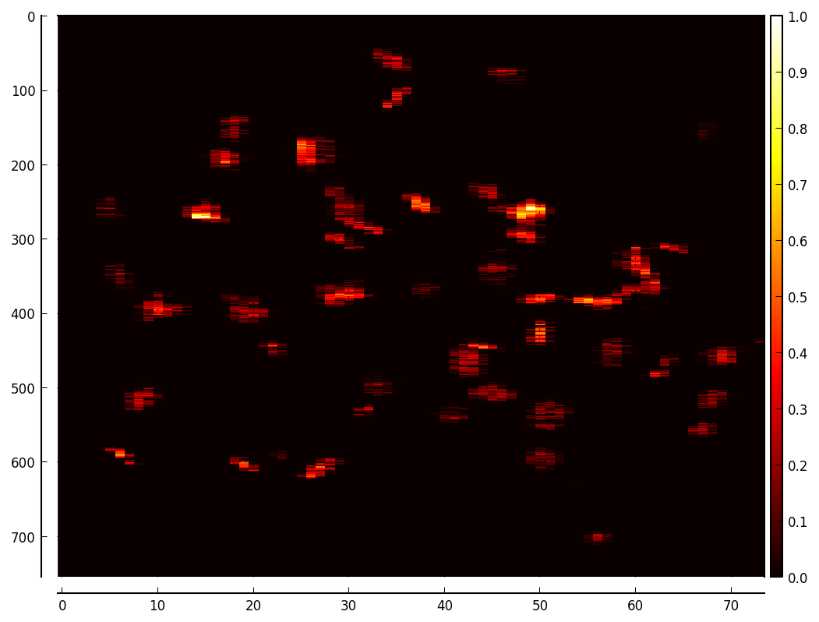
On-line evaluation of diffraction signal (+spot search)
DOZOR benchmark
DELL R930 off-the-shelf
2 x Intel E5-2699 v3, 36 cores / 72 threads
768 GB RAM
5000 Eiger4M frames, 16bit
Data in cache (!!!)
cbf’s : Average wall clock: 12.5 sec
Frames/Sec: 500
05/02/18
1

Slide 9

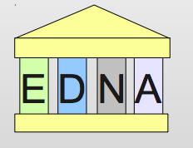
XML-RPC mystery
4x50K (numpy) floats
XML-RPC
Qt4 MXCuBE triggers DOZOR encapsulated in EDNA
On each line EDNA calls to ParallelProcessing.batch_processed method
that fills the heat map numpy array
All works fine with PILATUS6M – 25 Hz for years
After switching to EIGER – 750 Hz, we found several seconds delays
on EDNA processing at the XML-RPC call
Solved by sending/updating only one line at a time
Still, overhead (EDNA warppers + XML-RPC) approximately 1.5 seconds/bacth

Slide 10
Binding DOZOR to data flow
Change from:
ZMQ stream reciever -> Processing server RAM (cbf files)->
EDNA/DOZOR -> Storage
To
ZMQ stream reciever -> DOZOR -> Storage (cbf files)
DOZOR is being re-factored linkable with ZMQ stream reciever (C/C++)
MXCuBE will receive DOZOR results via regular HO Channel

Slide 11
Performance issues in Mesh&Collect
Limitations of Meshes
Flat
Poor special resolution
Expensive in terms of X-ray dose

Slide 12
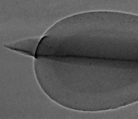
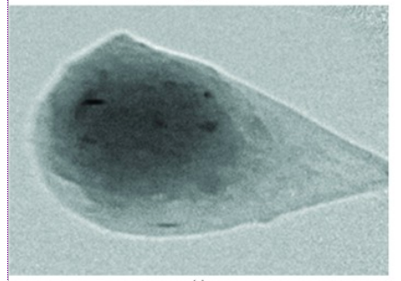
Anything better?
X-ray imaging
Brockhauser et al., J. Appl. Cryst. (2008). 41, 1057–1066
Warren et al., Acta Cryst. (2013). D69, 1252–1259

Slide 13
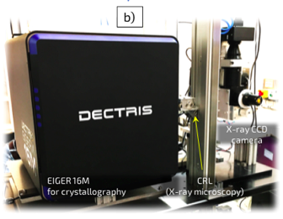
X-ray Imaging @ P14

Slide 14
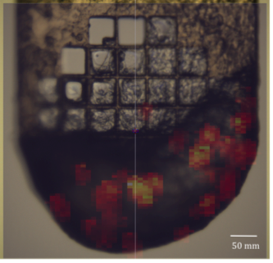
MeshScan vs Phase Contrast Image
75 seconds
300 kGy
resolution 10 μm
3 seconds
14 kGy (70 kGy/frame)
resolution 0.6 μm
75 seconds
300 kGy
Prerequisite: The beamline must (optionally) preserve flat wavefront

Slide 15
Summary
Low level implementations (motion control, hardware detector synchronization, etc.) are essential for efficient experimental procedures
Efficient GUI must be aware of deep details of such implementations
Efficient online analysis need to be coupled to low-level data management.
Phase contrast X-ray imaging is an extremely promising tool for multi-crystal experiments. Integration in MXCuBE started (solely for crystallography !!!).

Slide 16
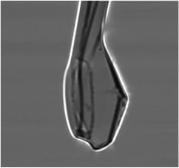
If you go for quality plenty of data for analytical absorption corrections are on the way

Slide 17
People involved
Ivars Karpics (MXCuBE)
Marina Nikolova (Data Acq, Data Management)
Sasha Popov
Jeremy Sinoir, Florent Cipriani
Imaging
Maxim Polikarpov, Anatoly Snigirev,
Sandor Brockhauser, Christian Csanko
Thomas Schneider

